Slide 1
Obstacle avoidance
Intelligent Transport Systems (MTAT.08.040)
Agnes Luhtaru & Janar Juusu

Slide 2
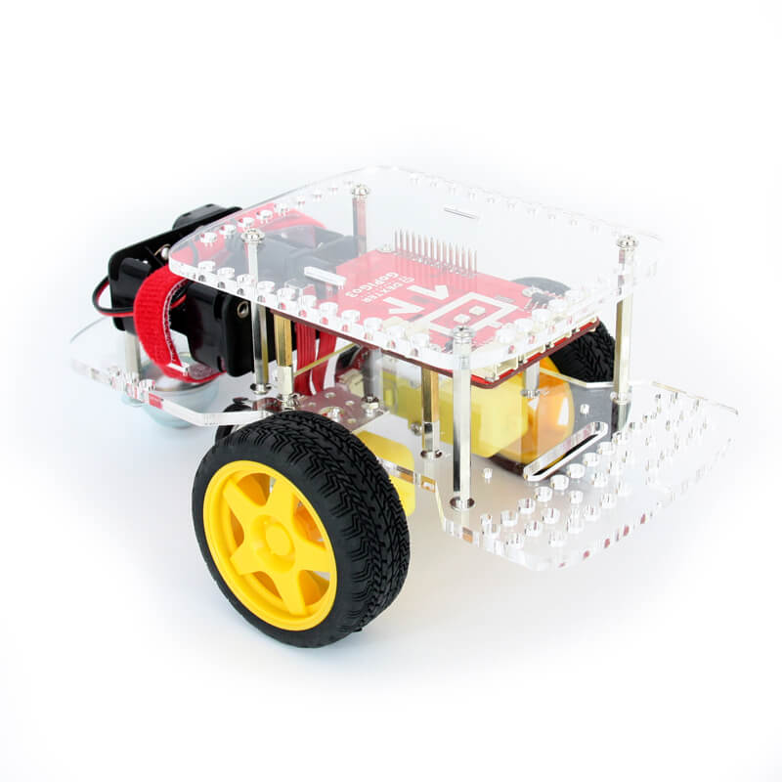
Target
Object/obstacle avoidance using ultrasonic sensors and camera images
GoPiGo robot or drones
Drive/fly through a labyrinth

Slide 3
Ultrasonic sensors
Distance measuring using ultrasonic waves
Sensors emits a wave and receives it back
Not affected by environment
Light
Smoke/dust
Color
Type of material (few exceptions, e.g. wool)
Does not go through transparent materials (glass, liquid)
Notes:
Infrared could be affected by black color or smoke

Slide 4
The algorithm & challenges
SLAM - Simultaneous localization and mapping
Some sort of machine learning - probably neural network(s)
Biggest challenge - doing it in real-time
Another challenge - where to do the calculation
Notes:
simultaneous localization and mapping (SLAM) is the computational problem of constructing or updating a map of an unknown environment while simultaneously keeping track of location within it.

